Slide 1
LONDON BRIDGE

Slide 2
PROJECT TEAM
Amaan Akhtar - 201P016 - 35
Chaitanya Parab - 201P022 - 28
Shaikh Mohd Shoeb - 201P029 - 45
Katheem Kizhar Ahmed - 201P036 - 11

Slide 3


Slide 4
PROBLEM STATEMENT :
We will be building a UI game using the Unity game engine & C# (a multi-paradigm programming language) Amongst various library we will be creating an AI-based pathfinding system through unity's NavMesh library during the process of development we will be using Blender, 3Ds max, Photoshop, Davinci resolve 16, Audacity & LMMS etc. For various effects and procedures such as character creation, rigging, animations we will use Adobe Fuse CC & Mixamo, Background score, & etc. The game will be built for PC which includes OS support of Windows, Linux & macOS. The post-development plan is to expand upon the project and add other platforms such as Xbox & Sony PS too.

Slide 5
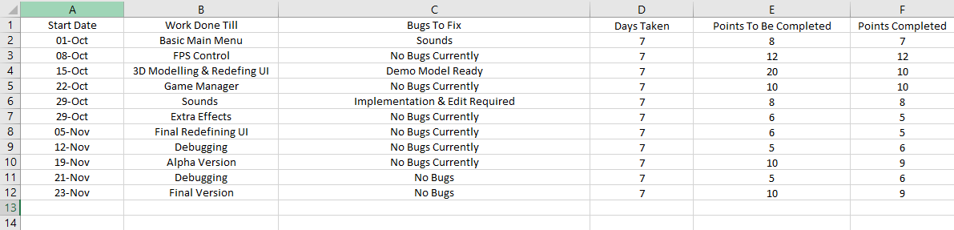
Plan of Execution in the form of Gantt Chart :

Slide 6

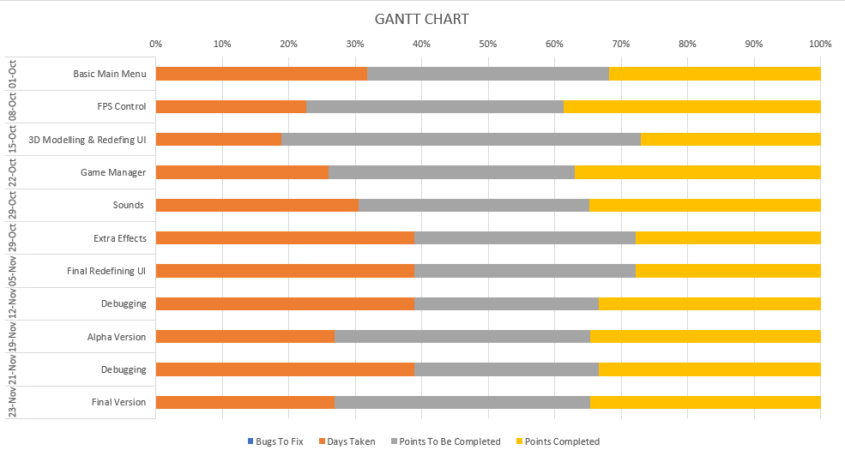

Slide 7
Literature Referred :
3D Game Development Using Unity Game Engine -
Pa.Meghal L.Nachammai ,T.M.Senthil Ganesan
http://www.internationaljournalssrg.org/IJCSE/2018/Volume5-Issue4/IJCSE-V5I4P104.pdf
Paper 2: 3D Game Development with Unity: A First-Person Shooter (FPS) Game - PENG XIA
https://www.theseus.fi/bitstream/handle/10024/71525/Xia_Peng.pdf?sequence=1&isAllowed=y

Slide 8
Work Done till Now :
System UI , i.e Main Menu
FPS Control
3D Modelling & Redefining UI
Game Manager
Sounds
Extra Effects
Debugging
Demo version
Final Debugging
Final Game
Trial Trailer

Slide 9
PROBLEMS OCCURRED
Buttons were not working properly.
We tried to find any problem in either code or assets . Finally found that an unnecessary object in between button and canvas which was interfering with pressing of button . So we finally removed it and it started working properly.
Not used to C# language
It was first time using c# language of many teammates but thanks to leader Amaan ,he mainly helped in coding part as well as taught us the necessary skills for coding.
Unity App was not supported by computer of few teammates
Due to most people having computer not compatible with Unity or not having a working computer , we used only one laptop ,viz. Chaitanya . And whenever we were working ,we were using screen sharing to be able to help each other in facing any difficulties.
Audio was not working properly
It was mainly problem related to coding and not adding correct component which was quickly solved by our leader, Amaan.

Slide 10
THANK YOU

